Slide 1

Alzheimer’s Disease Detection Using Deep Learning Techniques
Project Guide : Dr Krishan Kumar Sethi
Group Members Name : | Roll Number :
Ahmar Hasan Arish | 2006110
Ankit Kumar | 2006115
Vishal Anand | 2006181

Slide 2
Contents
Introduction
Existing Approaches
Proposed Approach
Performance Evaluation
Conclusion
References

Slide 3
Introduction: Alzheimer’s Disease
What is Alzheimer’s Diesease?
Alzheimer’s is currently ranked as the seventh leading cause of death in the United States and is the most common cause of dementia among older adults.
Alzheimer’s disease is a brain disorder that slowly destroys memory and thinking skills and, eventually, the ability to carry out the simplest tasks.
Memory problems are typically one of the first signs of Alzheimer’s, though initial symptoms may vary from person to person.
It causes loss of connections between nerve cells (neurons) in the brain.

Slide 4

Symptoms
Memory loss that disrupts daily life.
Taking longer to complete normal daily task.
Depression , Hallucination or Paranoia
Loss of appetite or restlessness.
Inability to combine muscle movements or jumbled speech.

Slide 5
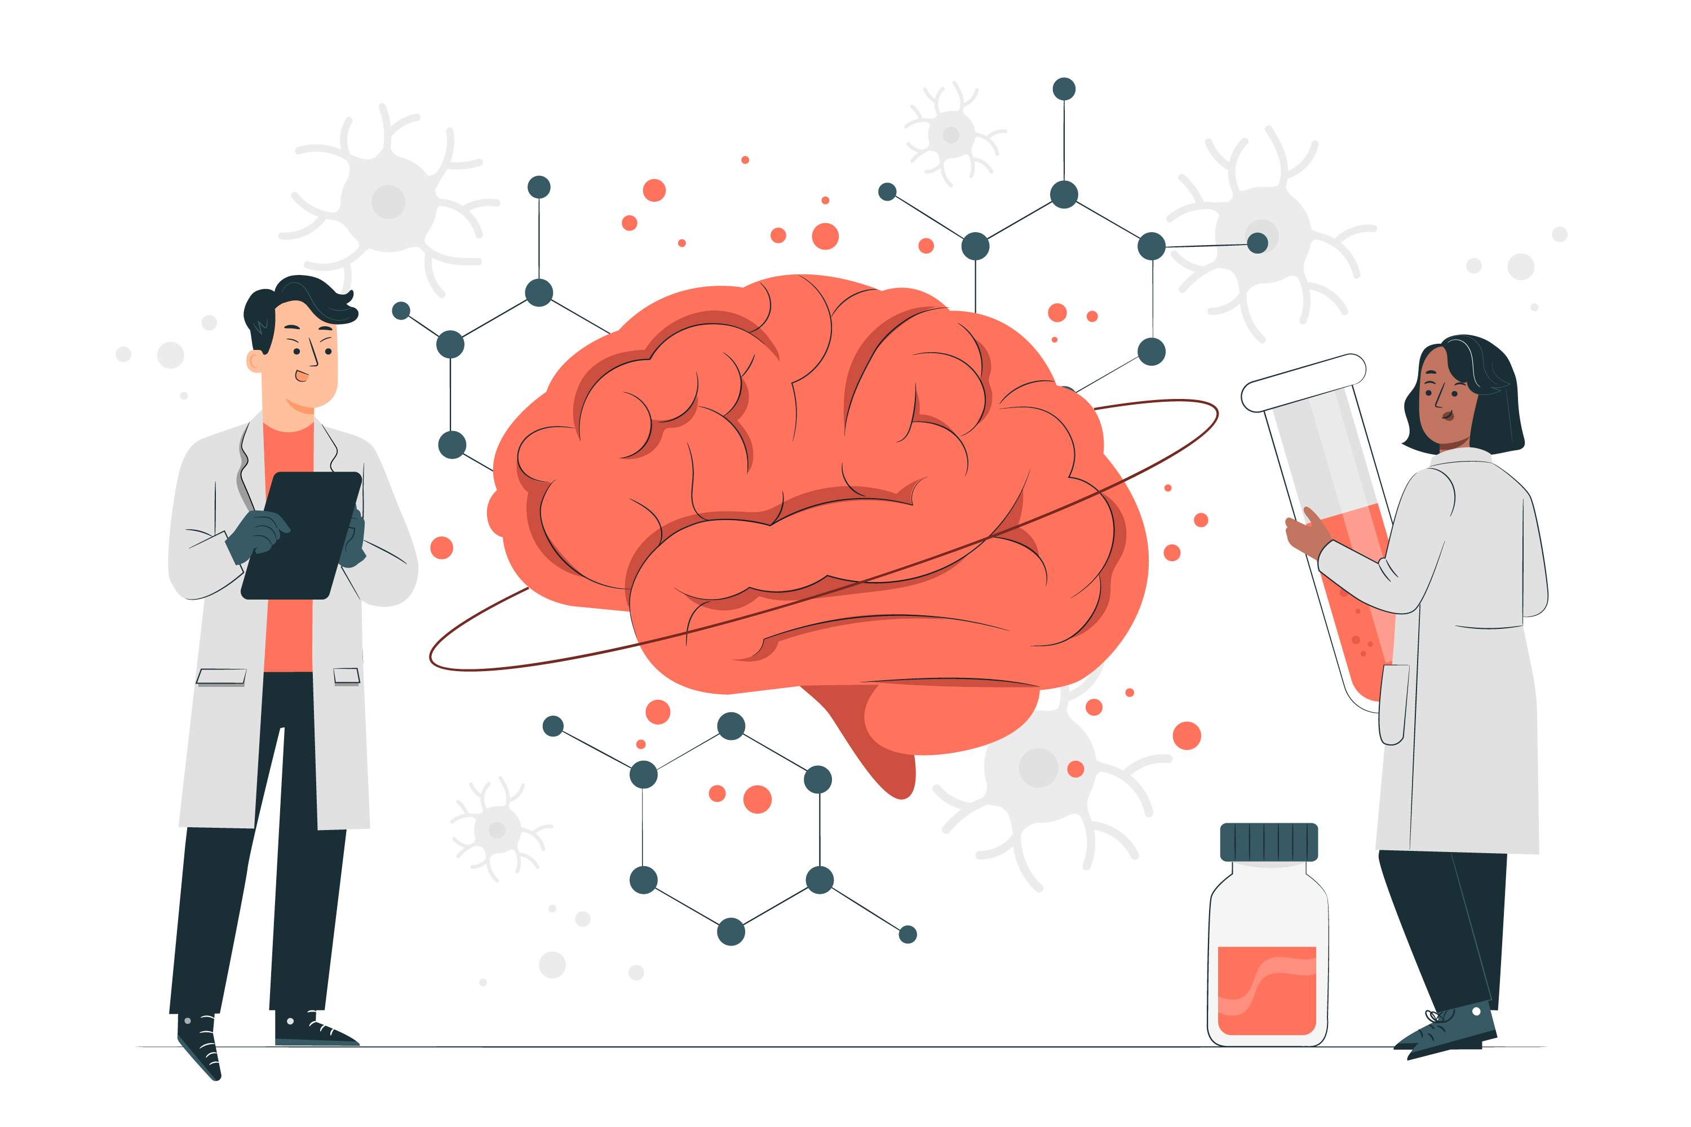
How is early-onset Alzheimer disease treated?
Currently there is no cure for this disease but several treatments are available –:
Medications
Lifestyle Changes
Cognitive therapy
Supportive care
Clinical trials

Slide 6
Previously Proposed Approaches For Detection of Alzheimer’s Disease
Prediction of Alzheimer’s disease using Support Vector Machine.
Prediction of Alzheimer’s disease using Convolutional Neural Network.

Slide 7
Proposed Idea for Alzheimer’s Disease detection
There are various ways to improve accuracy of the Alzheimer’s Disease prediction model – :
Inception model – It improves the performance of deep neural networks on image recognition tasks, while also reducing the computational cost and memory requirements of these models.
DenseNet model – The architecture was proposed to address the limitations of traditional CNNs, such as the vanishing gradient problem and the high computational cost of deep architectures.
Dropout – A regularization technique that randomly sets to zero some of the nodes in the neural network during training, effectively creating a smaller and robust model.

Slide 8
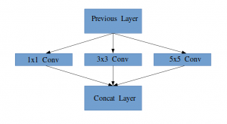
Inception Model
It is a combination of all the layers with their output filter banks concatenated into a single output vector forming the input of the next stage.
It allows the internal layers to pick and choose which filter size will be relevant to learn the required information.

Slide 9
Types of Inception Model
Inception-v1 It used a 22-layer deep CNN with multiple Inception modules.
Inception-v2 Updated version which includes batch normalization and factorization of convolutional layers.
Inception-v3 Updated version which includes better use of auxiliary classifiers and introducing factorized 7x7 convolutions.
Inception-v4 Upgraded version of Inception-v3, with deeper networks and improved accuracy.

Slide 10
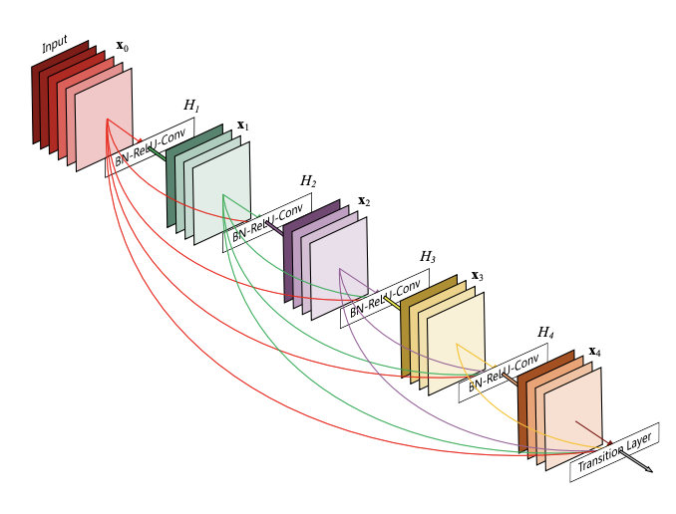
DenseNet Model
It is based on the idea of densely connecting every layer to every other layer in a feedforward neural network.
Each layer receives input directly from all preceding layers in the network.
Better information flow between layers because of dense connectivity.
Make use of "skip connections", which enable the direct propagation of information from one layer to another.
Solves the problem of vanishing gradient.

Slide 11
Types of DenseNet Model
DenseNet-121 This is the smallest version with 121 layers. It has about 8 million parameters.
DenseNet-169 This is a larger version with 169 layers and about 14 million parameters.
DenseNet-201 This is an even larger version with 201 layers and about 20 million parameters.
DenseNet-264 This is the largest version with 264 layers and about 33 million parameters.

Slide 12
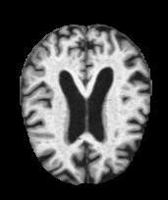
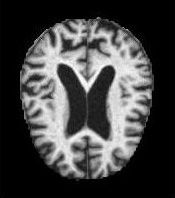
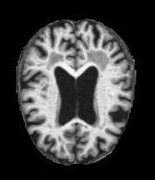
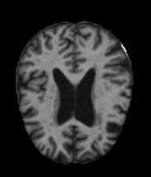
Dataset - Used
The ADNI dataset is a collection of data obtained from participants in the Alzheimer's Disease Neuroimaging Initiative (ADNI) study launched in 2004 that aims to improve our understanding of Alzheimer's disease by identifying biomarkers and developing better methods of diagnosis, treatment, and prevention.
Dataset consists of two files - Training and Testing both containing a total of around ~5000 images each segregated into the severity of Alzheimer’s classes.
Mild-Demented
Moderate-Demented
Non-Demented
Very Mild-Demented

Slide 13
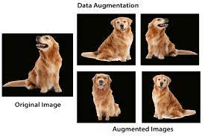
Data Pre-processing :
Performed Image Data Augmentation on given MRI data -:
Creating new images from existing ones.
Achieved by making small changes to existing images such as adjusting the brightness of the image, or rotating the image, or shifting the subject in the image horizontally or vertically.
Increases the size of your training set, thereby providing much more data to your model for training.

Slide 14
Data Pre-processing :
The input images are resized to 224x224 pixels before being fed into the model.
Labels are one-hot encoded.
Batch size used is of 32,it indicates that the generator will generate batches of 32 samples each.
Performing over-sampling of data since the classes are imbalanced.

Slide 15
Deep Learning Models Used - :
Convolutional Neural Network
Inception Model
Dense Network Model
Recurrent Neural Network

Slide 16
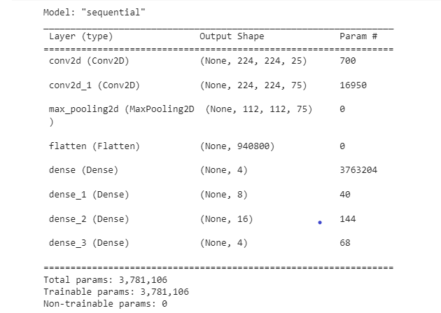
CNN Model Summary

Slide 17
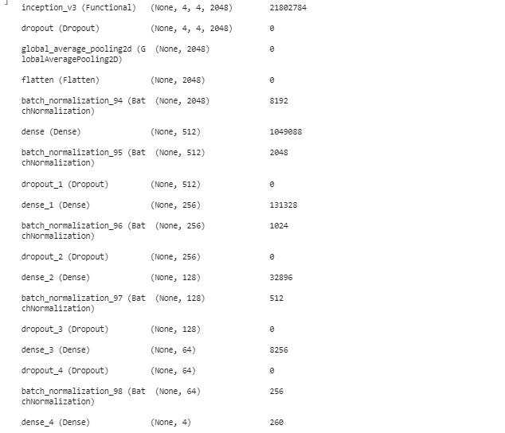
Inception Model Summary

Slide 18
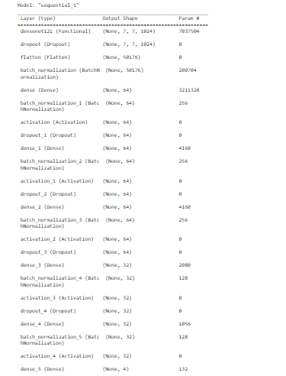
DenseNet Model Summary

Slide 19
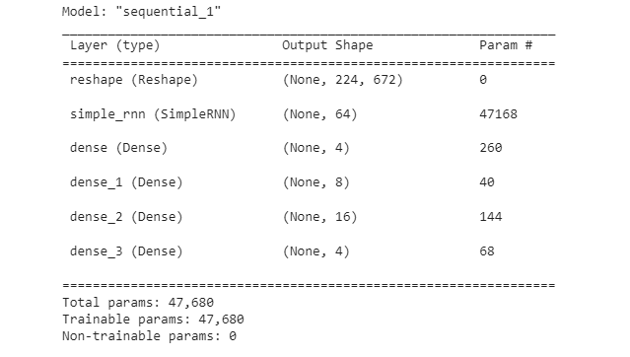
RNN Model Summary

Slide 20
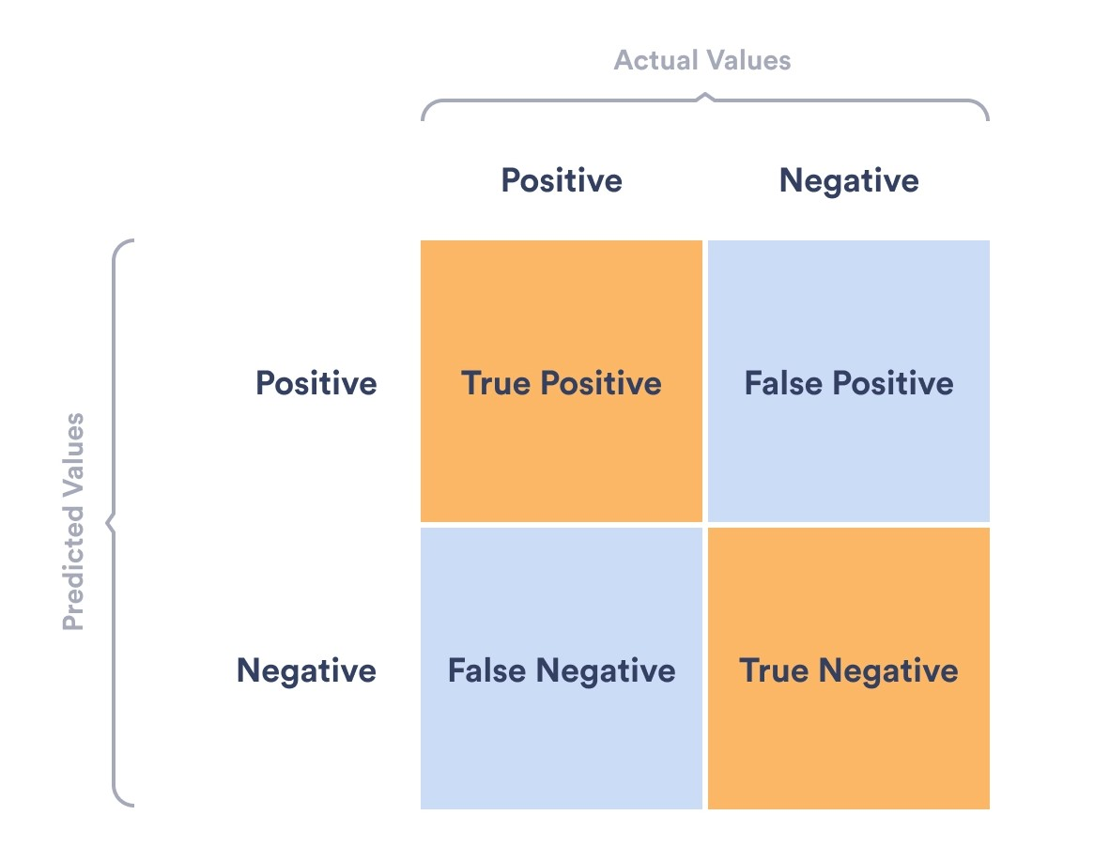
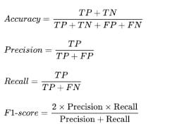
Evaluation Metrics

Slide 21
Results :
Models | Accuracy (%) | F1 Score (%) | Precision (%) | Recall (%)
CNN | 75.02 | 50.03 | 50.03 | 50.03
Inception-v3 | 92.27 | 85.38 | 86.29 | 84.50
DenseNet-121 | 76.83 | 53.79 | 52.07 | 52.90
RNN | 75.02 | 36.59 | 50.06 | 29.24

Slide 22
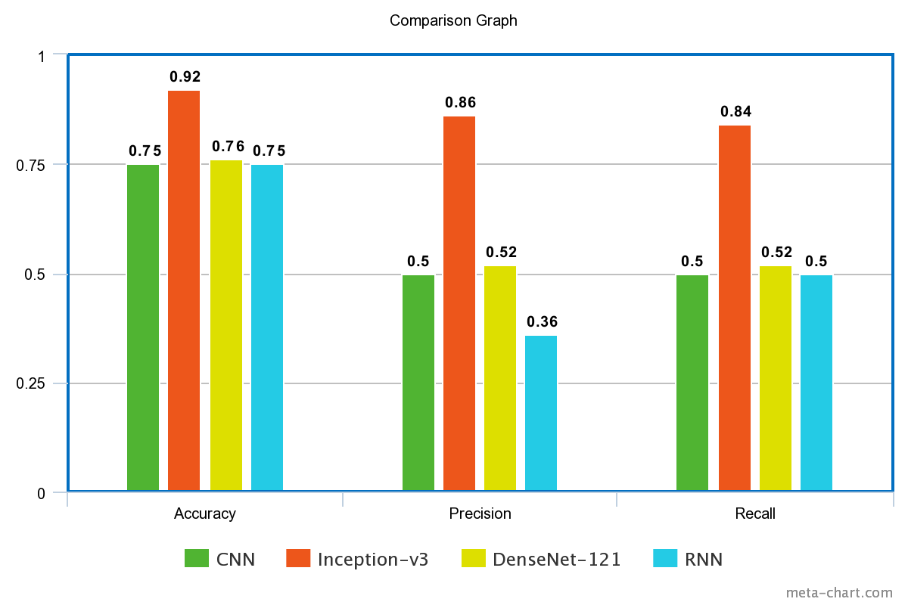
Comparison Graph

Slide 23
Conclusion
Alzheimer’s disease is distinguished by the formation of abnormal protein bundles in brain tissue, but experts are unsure what causes the condition. To find a cure or aversion, researchers need to know more than just that there are protein deviations from the norm; they also need to know how these brain nerves arise in order to find a solution.
Our observation has shown that accuracy can be improved by using Inception-v3 model and by using DenseNet-121 as compared to typical CNN and SVM. Introducing regularization technique has also worked in improving the accuracy of the model. Out of them all , Inception-v3 model has best performed with accuracy of 92.27%.
SVMs are particularly useful when the number of features is relatively small compared to the number of samples and when the classes are well-separated.
RNN works on sequential data where input data is a sequence. Hence it didn’t perform well on ADNI MRI datasets.

Slide 24
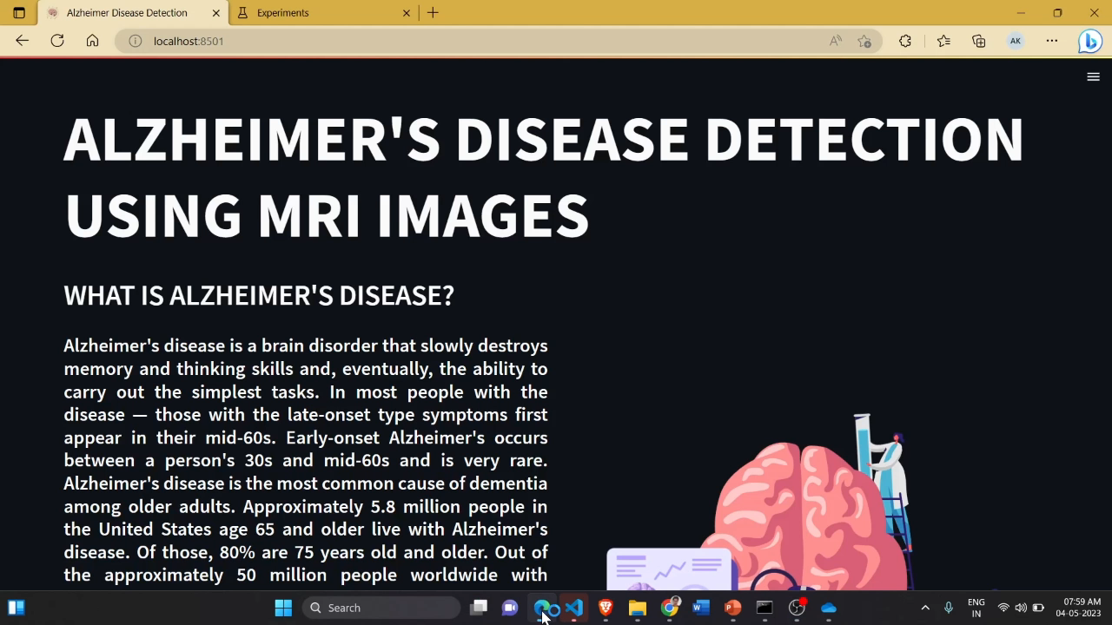

Slide 25
References
S. Al-Shoukry, T. H. Rassem and N. M. Makbol, "Alzheimer’s Diseases Detection by Using Deep Learning Algorithms: A Mini-Review," in IEEE Access, vol. 8, pp. 77131-77141, 2020, doi: 10.1109/ACCESS.2020.2989396..
K. A. N. N. P. Gunawardena, R. N. Rajapakse and N. D. Kodikara, "Applying convolutional neural networks for pre-detection of alzheimer's disease from structural MRI data," 2017 24th International Conference on Mechatronics and Machine Vision in Practice (M2VIP), Auckland, New Zealand, 2017, pp. 1-7, doi: 10.1109/M2VIP.2017.8211486.
Mustafa Kamal, A. Raghuvira Pratap, Mohd Naved, Abu Sarwar Zamani, P. Nancy, Mahyudin Ritonga, Surendra Kumar Shukla,and F. Sammy(2022), “Machine Learning and Image Processing Enabled Evolutionary Framework for Brain MRI Analysis for Alzheimer’s Disease Detection”

Slide 26


